Slide 1
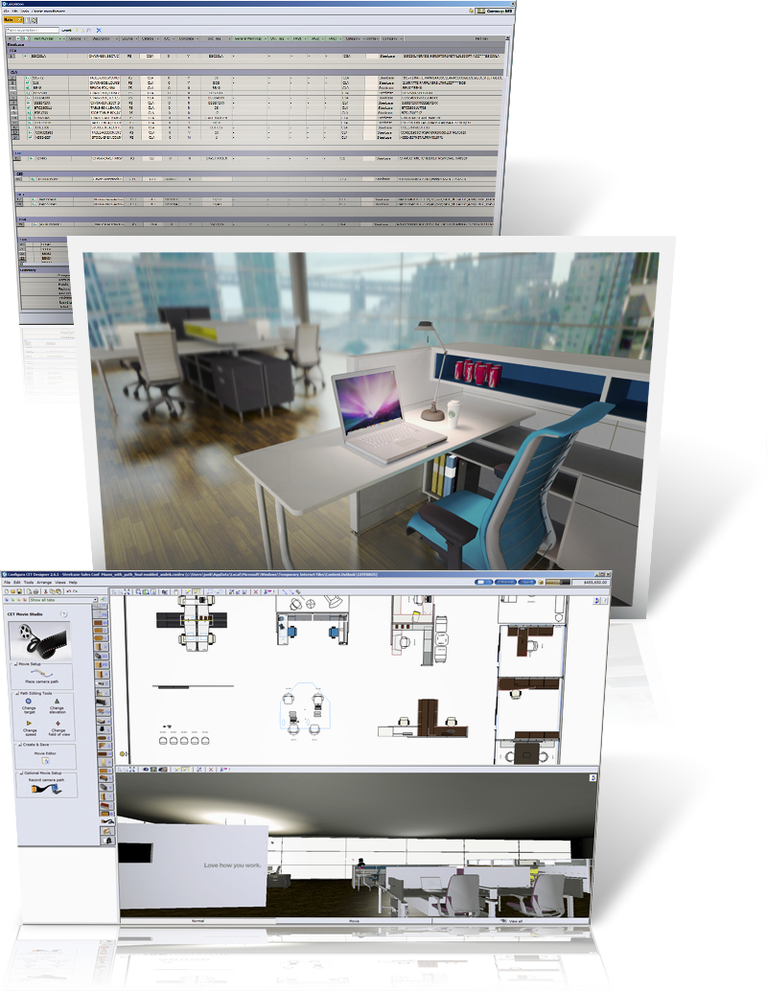
Design Checks and Process Change
Cate Sword Kornoely

Slide 2
Process Change
Change the way you work
Change role of Designers
Change your output

Slide 3
Presentation tools
Alternatives
Renderings
Movies

Slide 4
Productivity tools
Freeze
Blocks
Tagging

Slide 5
Standards to improve productivity
Titleblocks
Article view templates
Categories/Visibility settings

Slide 6
Hardware and software changes
Laptops for client meetings
GoToMeeting
MyConfigura
Email pdf
Screen Captures

Slide 7
Tips for making the change
Checking
Converting Projects
Reconfigurations
Installation drawings

Slide 8
Checking
Use part tagging for breaking the drawing down into smaller clusters
Create Article Views and Panel Types of each cluster
Modify Individual Tags
OK ✓

Slide 9
Converting Projects
Redraw when reconfiguring
Convert with ProjectSymbols tool
“Trace” over the AutoCAD drawing with smart objects in your extension
Outsource the conversion
Use as a training project for new designers

Slide 10
Reconfigs
Use the Reconfiguration Tags for small changes
Use the Reconfiguration tool for large ones. You can even compare sif to sif

Slide 11
Installation Drawings
Link the Project Symbol layers to the correct Categories
Create set of notes as favorites that can be inserted quickly and modified
Have smart data fields in the title blocks
Print both the papers and the Article views to pdf, then print only the sheets you need to change (that way the page numbers are correct)

Slide 12

Thank you!
Questions?
Contact me:
cate@catesword.com
www.catesword.com

